Slide 1
Bridge Pattern
By
Narendran, S S

Slide 2
Key Items
Decoupling.
Similar to Adapter
Abstraction & Refined Abstraction.
Implementor & Concrete Implementors

Slide 3
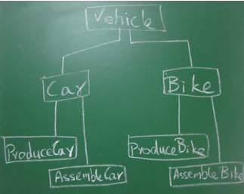
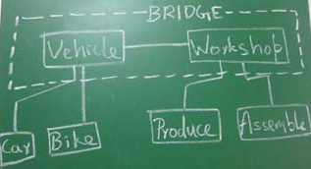
Bridge Pattern
The bridge pattern is a design pattern used in software engineering which is meant to "decouple an abstraction from its implementation so that the two can vary independently".
Notes:
The pattern is similar to the Adapter pattern, except the Bridge pattern separates the interface from implementation.
The display of different image formats on different operating systems is a good example of the Bridge pattern

Slide 4
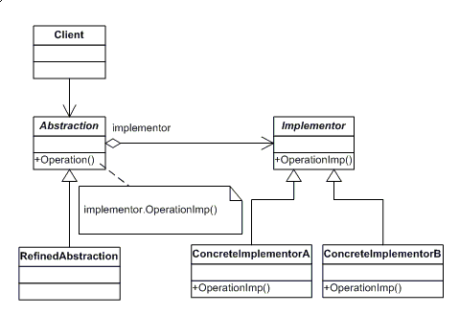
Bridge Pattern - UML

Slide 5
Pros and Cons
Pros
All Implementations can be changed
Full Decoupling of dependencies.
Cons
One of the major drawbacks of this pattern is that, in providing flexibility, it increases complexity. There's also possible performance issues with the indirection of messages - the abstraction needs to pass messages along to the implementation for the operation to get executed.

Slide 6
References
http://java.dzone.com/articles/design-patterns-bridge
http://sourcemaking.com/design_patterns/bridge

